Slide 1


MyGlooco
Empowering Diabetes Self-Management

Slide 2


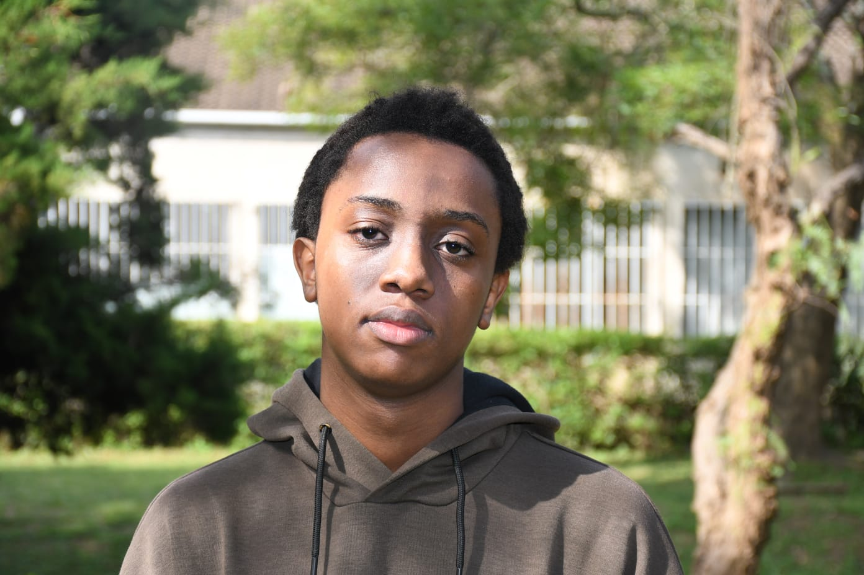
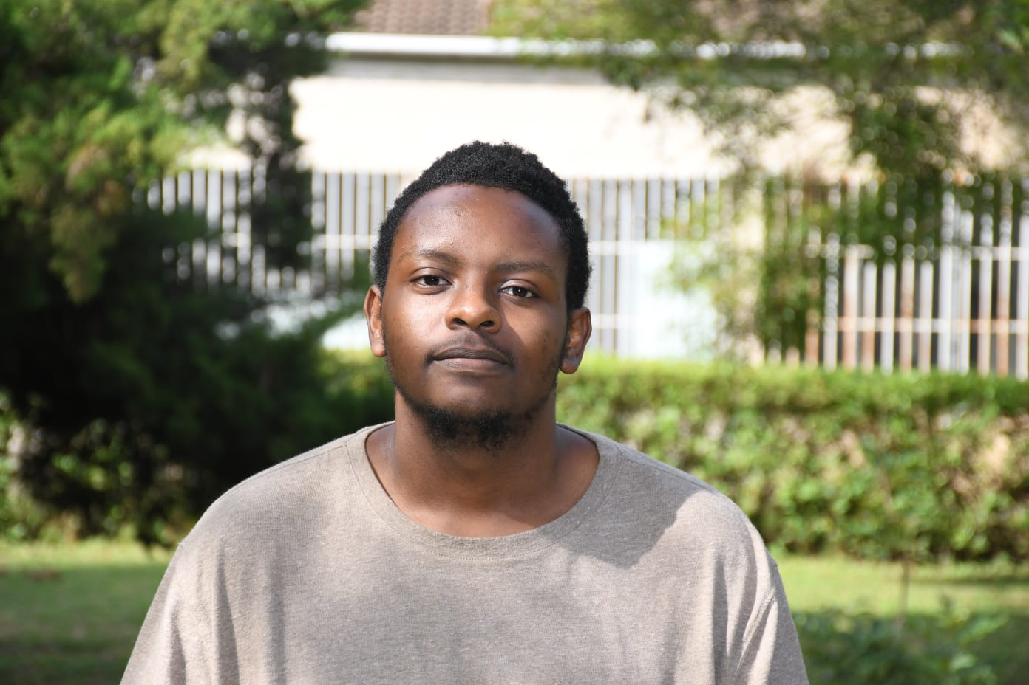
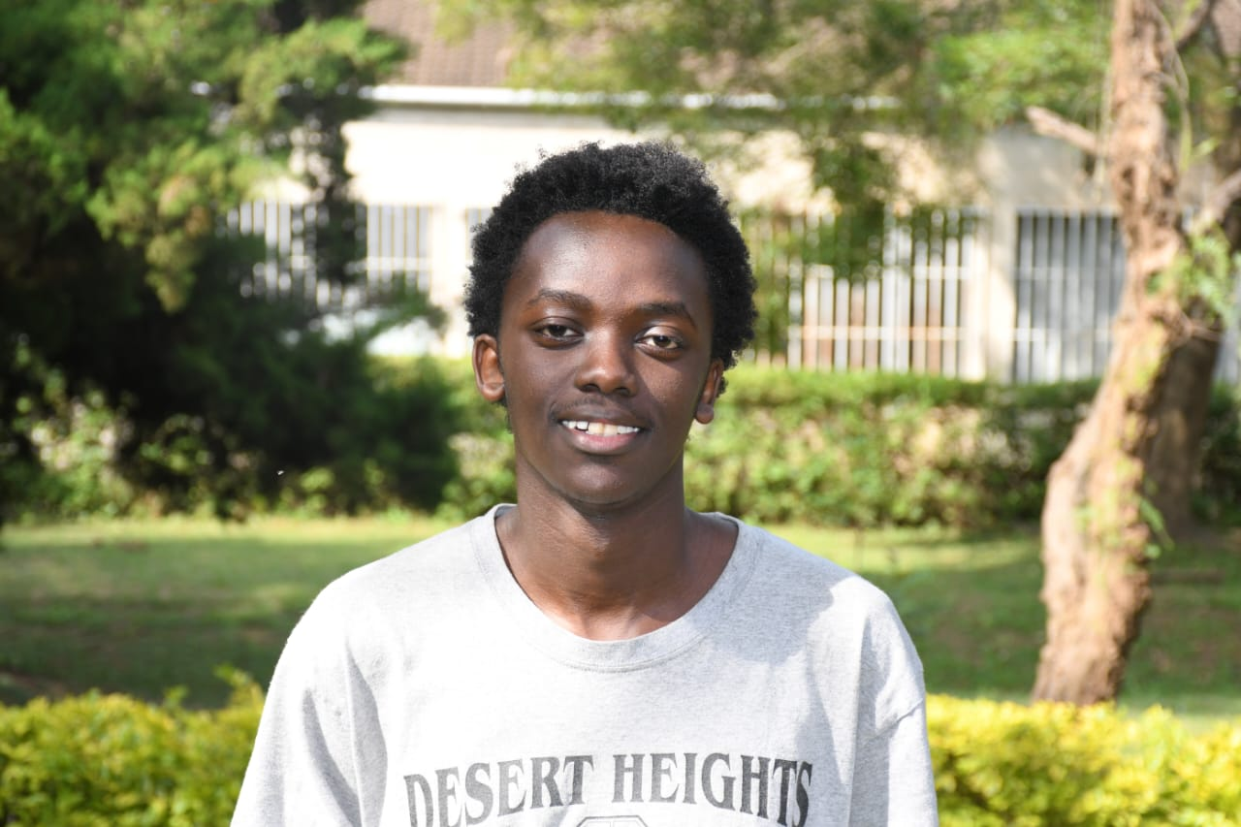
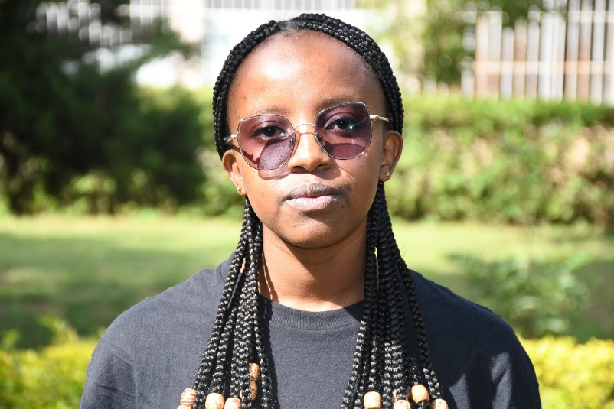
The Team
Dr Lawrence Nderu
Principal Investigator
Joseph Muema
Team Lead
Jayden Mathenge
UI/UX Designer
Kelly Kasina
Frontend Dev
Joseph Njenga
Database Dev
Terry Mutheu
Frontend Dev

Slide 3
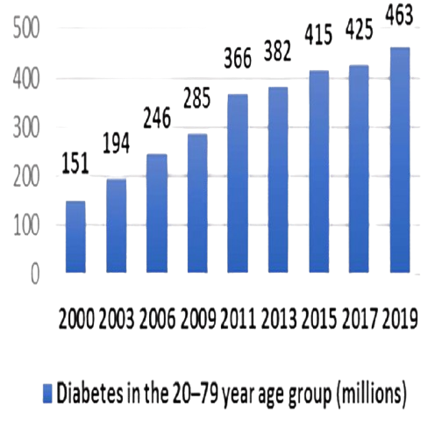
Problem Statement & Justification
Rising diabetes prevalence worldwide.
Traditional management tools lack personalization and portability.
Current challenges: inconsistent monitoring, generic solutions, and lack of integration across health domains.

Slide 4
What we offer
Blood Sugar Tracking: Manual input and dual-curve visualization.
Diet Tracking: Meal logging, local recipe database, and plate interface for custom meals.
Physical Activity : Logging exercises and tracking activity history.
Medication : Management, reminders, and refill alerts.
Quality of Life Systems: Report generation and educational resources.
Blood Sugar Tracking
Medication Management
Quality of Life
Physical Activity
Diet Tracking

Slide 5
Commercial Viability & Revenue Model
Revenue Generation: Freemium model with paid subscription tiers.
Target Users: Individuals with diabetes, caregivers, and healthcare professionals.
Pricing Model: Free access to basic features (blood sugar recording, meal logging, medication tracking, education) with advanced features (prediction, detailed analytics, comprehensive reports, etc.) available via subscription.
Competitor Analysis: Differentiation through cultural relevance and user personalization.

Slide 6
Market Entry Strategy
Marketing Approach: Digital marketing, social media campaigns, partnerships with local clinics and diabetes associations.
User Acquisition: Early-adopter incentives/benefits, pilot testing in key urban areas, and word-of-mouth.
Pilot Testing Plan: Structured testing with real users through feedback collection and iterative improvements.

Slide 7
Resources Required
Software: Flutter development tools, Firebase cloud services.
Possible External Partnerships: Collaborations with local health organizations, government agencies, and healthcare providers.
Budget Considerations: Flutterflow and Blaze(Firebase) subscriptions.

Slide 8
Future Roadmap
BG Prediction
Improved Analytics
Market Expansion
Product Refinement
Short-Term Enhancements: Integration of blood sugar prediction model, improved analytics.
Long-Term Vision: Broader data integration, Regional Market expansion, and continuous product refinement.

Slide 9



Thank you!
Our Website
Contact us:
+254 798 730 844
josephmuema443@gmail.com
In partnership with:

